Slide 1

Project Title - Healthcare Analytics for Doctor Visits
Student Name - Abhijit Bhattacharjya
AICTE STUDENT ID - STU6a5e32203a7001784558112

Slide 2

PROBLEM STATEMENT
Doctor-visit patterns can vary across demographic characteristics, health conditions, illness levels, chronic conditions, and healthcare-support factors. However, raw healthcare data does not clearly show how these factors are related to the frequency of doctor visits. The problem is to analyze the given healthcare dataset and identify meaningful patterns, relationships, and differences in doctor visits across different population and health-related groups using data analytics and visualization techniques.

Slide 3
Project Description
This project analyzes the Healthcare Analytics for Doctor Visits dataset using Python-based data analytics. The analysis examines doctor-visit patterns across gender, age, income level, illness, reduced activity, health status, chronic conditions, and healthcare-support factors. The project uses data cleaning, descriptive statistics, univariate, bivariate and multivariate analysis, correlation analysis, and data visualization to identify meaningful patterns and relationships in doctor visits.

Slide 4

WHO ARE THE END USERS?
Healthcare Administrators
Doctors and Healthcare Professionals
Public Health Researchers
Healthcare Planners
Government Health Departments
Data Analysts
Healthcare Organizations / Hospitals

Slide 5

Technology Used
  Programming Language: Python
  Libraries: Pandas, NumPy, Matplotlib, Seaborn
  Platform: Google Colab
  Techniques:
    Data Cleaning and Preparation
    Descriptive Statistics
    Univariate Analysis
    Bivariate Analysis
    Multivariate Analysis
    Correlation Analysis
    Data Visualization

Slide 6
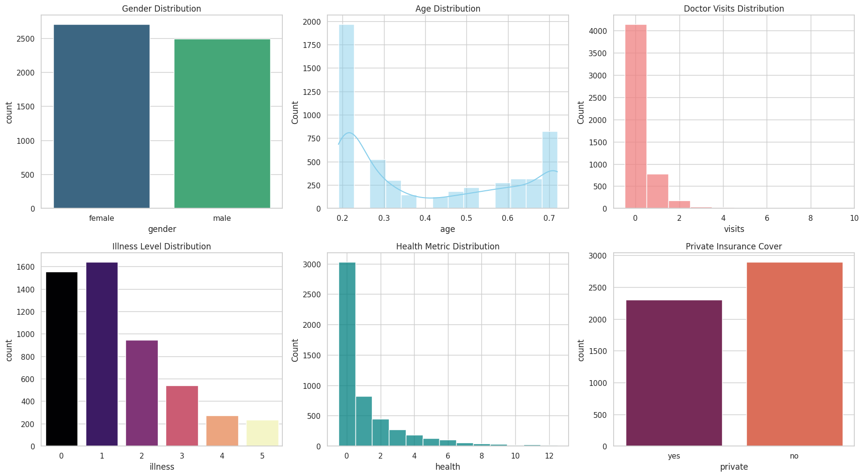
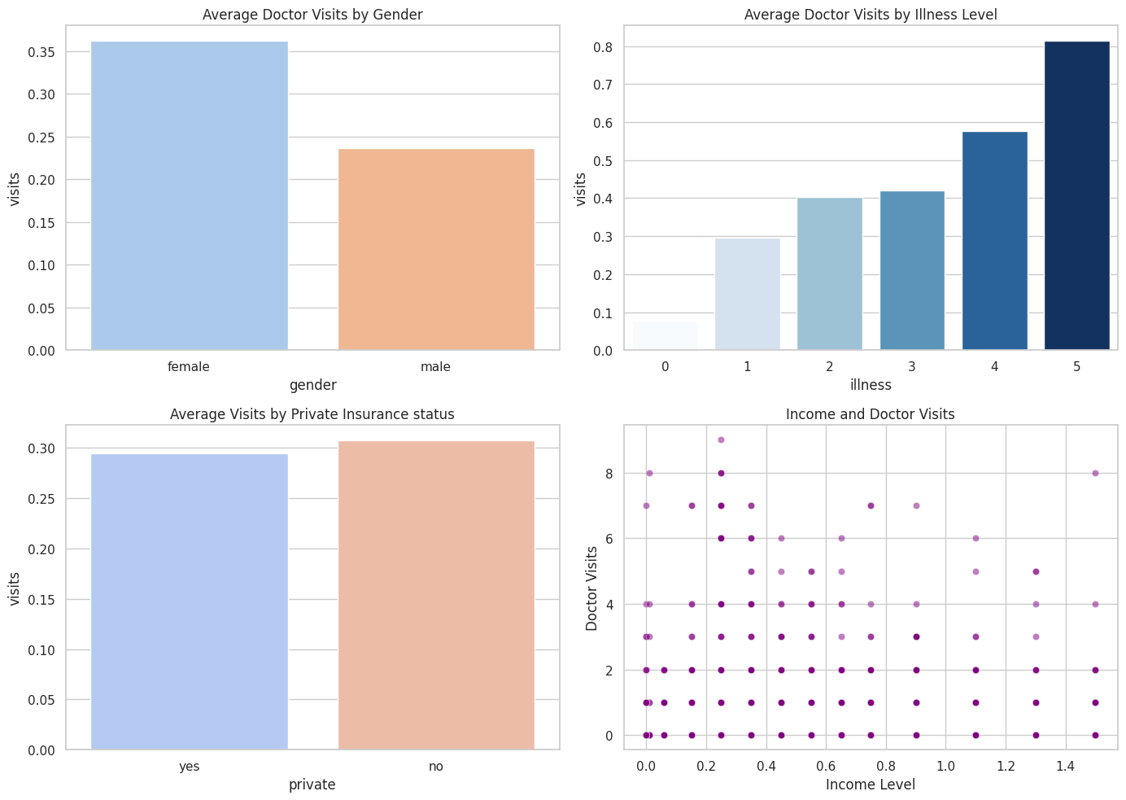
RESULTS
GitHub Link
Univariate Analysis
Bivariate Analysis

Slide 7
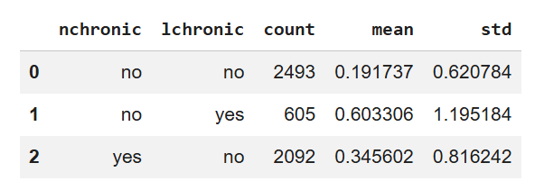
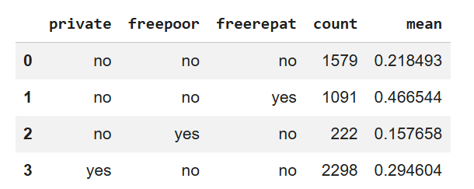
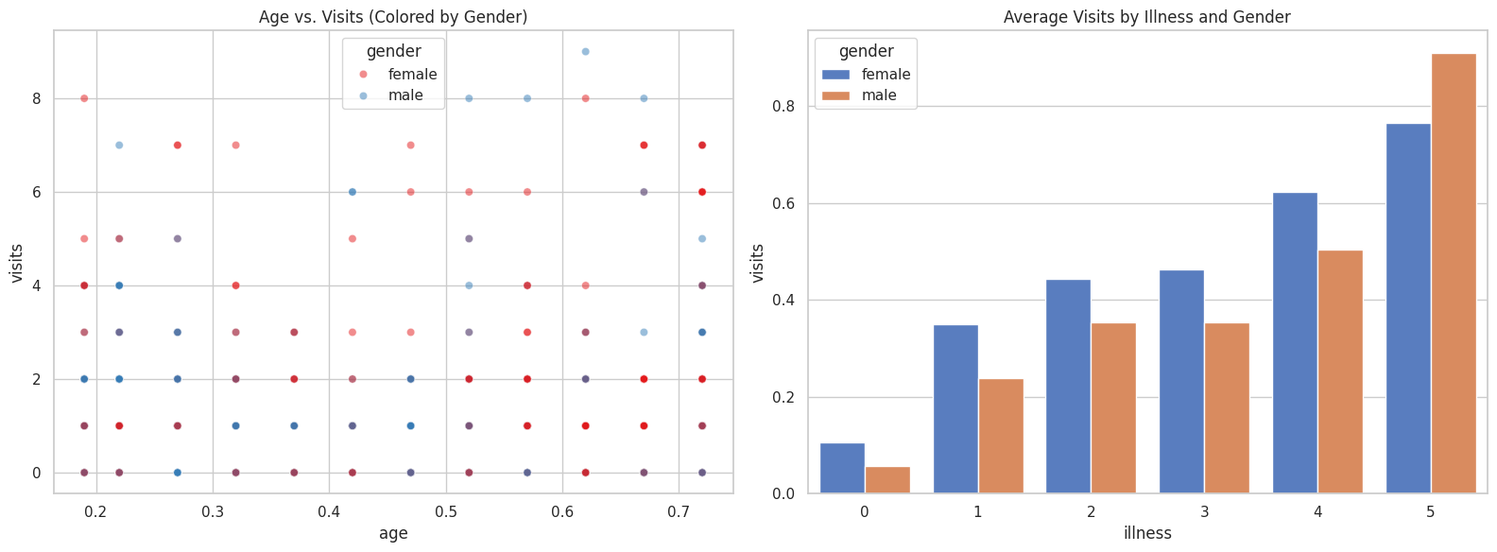
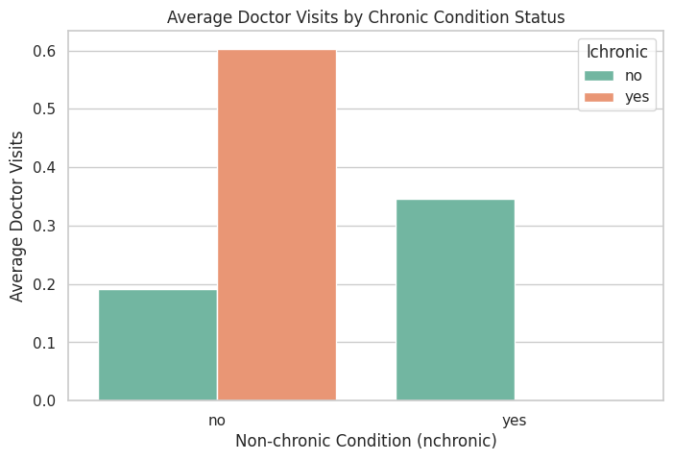
RESULTS
GitHub Link
Multivariate Analysis
Chronic Condition Analysis

Slide 8
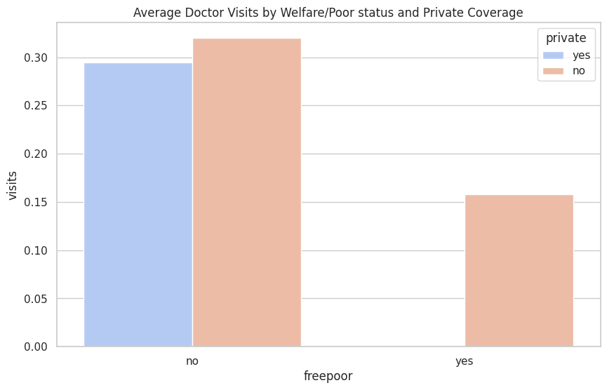
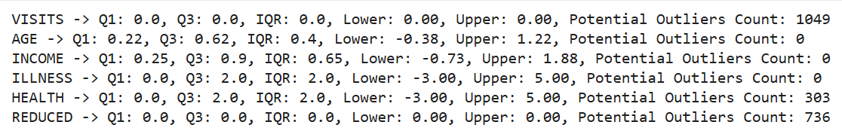
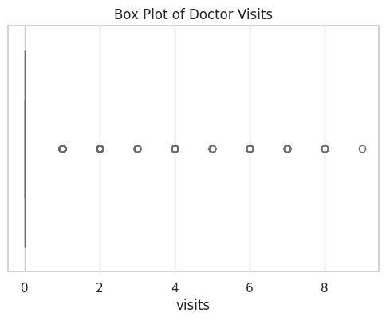
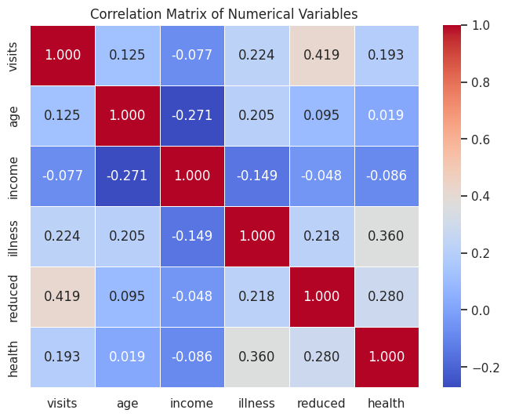
RESULTS
GitHub Link

Slide 9
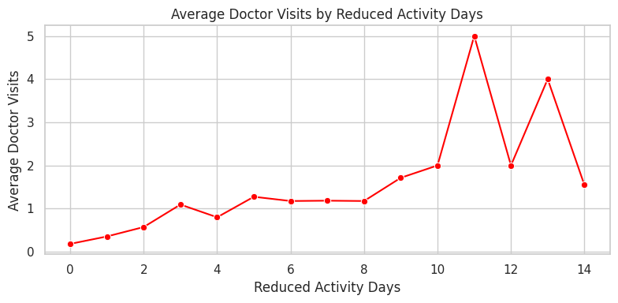
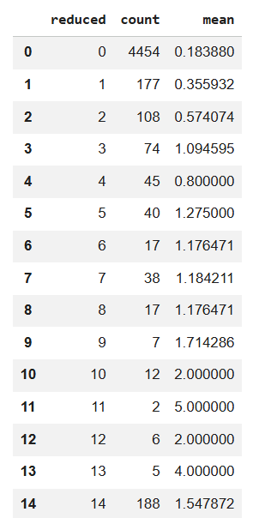
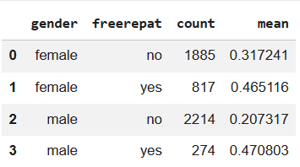
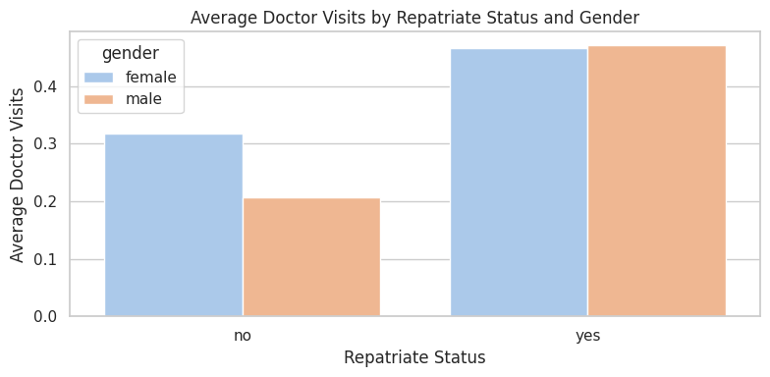
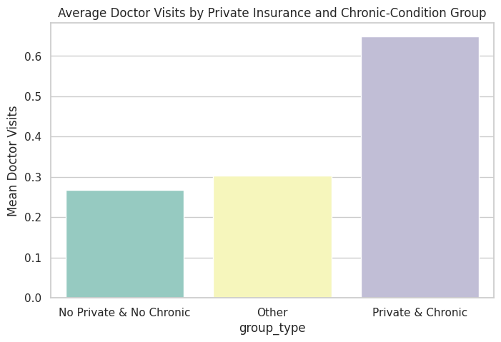
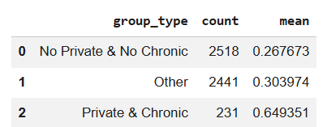
RESULTS
GitHub Link

Slide 10
Thank you
Healthcare Analytics for Doctor Visits
By
Abhijit Bhattacharjya
.
.

